Slide 1


Spring Framework - Spring Security
In memory & database authentication, JWT, Oauth 2

Slide 2


Content
1) Introduction to Spring Security
2) Authentication Manager in Spring Security
3) Authentication & Authorization basics
4) Implementing In memory & database authentication
5) JWT 6) Oauth 2

Slide 3
Introduction to Spring Security
Spring Security is a powerful and highly customizable authentication and access-control framework. It is the de-facto standard for securing Spring-based applications.
Spring Security is one of the Spring projects that is designed and developed for securing Spring-based applications. It is a standard framework that can be used to secure the Spring applications.
It helps to resolve all the security issues that come during creating non-security Spring applications. It was first released in 2008 as Spring Security 2.0.0.
It focuses on authentication and authorization to secure the application. Authentication is the process of knowing and identifying the user that wants to access and Authorization is the process to allow the authority to perform actions and access the resources in the Spring application.
It contains several modules to deal with various domains such as remote, web, etc. See, the module list below.

Slide 4
Spring Security Modules
Spring Security is made of several independent modules such as core, auth, test, etc. We are listing some module names:
Core: It includes Spring Security's core classes and interfaces related to authentication and application access control.
Remoting: It is used for handling the Spring Remoting application and contains the necessary classes.
Aspect: It is used to include Aspect-Oriented Programming (AOP) support within Spring Security.
Config: It is used to configure the Spring Security application by using XML and Java.
Crypto: This module contains classes and interfaces for cryptography support.
Data: It is used to integrate Spring Security with Spring Data.
Messaging: It is helpful to implement messaging in the application.

Slide 5
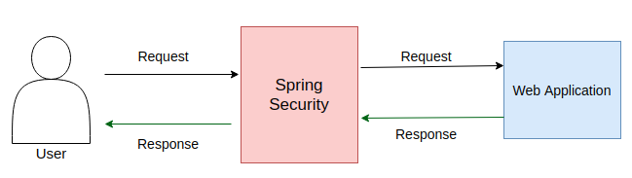
OAuth2: It includes classes and interface for OAuth 2.x within Spring Security:
OpenID: It provides support to integrate OpenID web-authentication.
CAS: CAS (Central Authentication Service) client integration.
TagLib: It contains several tag libraries regarding Spring Security.
Test: It adds testing support in the Spring Security.
Web: It contains web security code, such as filters and Servlet API dependencies.

Slide 6
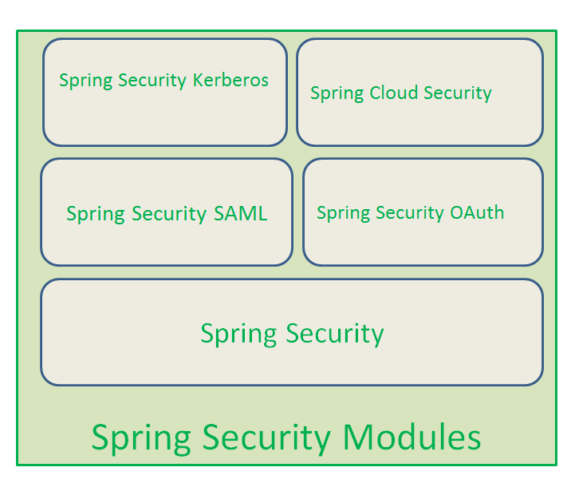

Slide 7
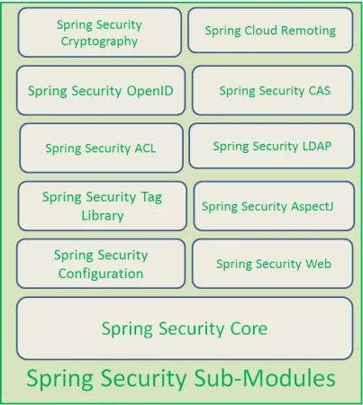

Slide 8
Advantages of Spring Security
Authentication and Authorization Support
Protection against malicious programs
Extensible
Integration with Spring MVC
Portability
CSRF protection
Java Configuration support
Easily to maintain
Proper documentation

Slide 9
Spring security works on the following three core concepts
Authentication.
Authorization
Password Storage
Servlet Filters

Slide 10
1.1. Authentication:
Used to verify if a user using an application by providing valid credentials used to verify who you are! Authentication is establishing identity of a principal (user, system, that can perform an action in an application).

Slide 11
1.2. Authorization:
This is besides the authentication. For a simple application, authenticating user might be enough, but let’s think about a big enterprise application.
A normal employee (e.g. Call center agent) may have only limited permission to carry out certain operations.We don’t want to allow this employee to perform other operations
Our back-end product manager allowed to work only on the products. We don’t allow product manager to change customer information or order information.
Ecommerce manager can work on both customer and order information, but they can’t change product information.
System admin can perform all the operations.
With simple authentication, we can’t restrict logged in user as we don’t have information about user privileges or permissions. Authorization helps to provide this information before the user tries to access a resource. It is a process of access control, deciding whether it allows a principal to perform an action (access-control → admin, user, leader, manager, contractor, anonymous etc) or not.

Slide 12
1.3 Password Storage
Making sure that our passwords are secure and difficult to hack is another primary goal of any security framework. Spring Security’s PasswordEncoder interface perform one way transform for the password (We can’t decrypt the password).Spring Security provides several PasswordEncoder, Here is a list for your reference:
BCryptPasswordEncoder.
Argon2PasswordEncoder.
Pbkdf2PasswordEncoder
SCryptPasswordEncoder.
[pullquote align=”normal”] Read Password encoding in spring security to get more details about how the password encoder works with Spring Security [/pullquote]

Slide 13
1.4 Servlet Filters
Spring security uses the Java servlet filters to start the security check for our web application.

Slide 14
Spring Security Features
Authentication and Authorization.
Supports BASIC,Digest and Form-Based Authentication.
Supports LDAP Authentication.
Supports OpenID Authentication.
Supports SSO (Single Sign-On) Implementation.
Supports Cross-Site Request Forgery (CSRF) Implementation.
Supports “Remember-Me” Feature through HTTP Cookies.
Supports Implementation of ACLs
Supports “Channel Security” that means automatically switching between HTTP and HTTPS.
Supports I18N (Internationalisation).
Supports JAAS (Java Authentication and Authorization Service).
Supports Flow Authorization using Spring WebFlow Framework.
Supports WS-Security using Spring Web Services.
Supports Both XML Configuration and Annotations. Very Less or minimal XML Configuration.
Spring 4.x Security Framework supports the following New Features:
Supports WebSocket Security.
Supports Spring Data Integration.
CSRF Token Argument Resolver.

Slide 15
Basic components of Spring Security
AuthenticationFilter
AuthenticationManager
AuthenticationProvider
UserDetailsService
PasswordEncoder
Spring Security Context
Form Login
Login with a Database
Login Attempts Limit

Slide 16
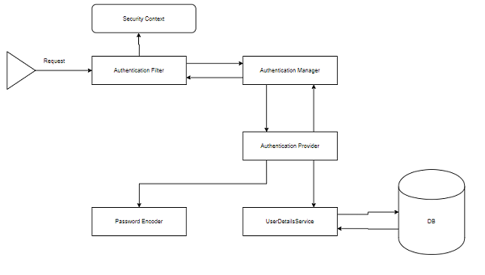
Components of Spring Security Architecture

Slide 17
Authentication Manager in Spring Security
Authentication Manager is a static class that manages the authentication modules that an application uses.
When a request is made to protected resources, the Authentication Manager calls the Authenticate method to get an Authorization instance to use in subsequent requests.
One of the core aim for any security framework is to verify the caller’s claim, the caller is who they claim to be. Authentication is the process to validate credentials and caller’s claim.

Slide 18
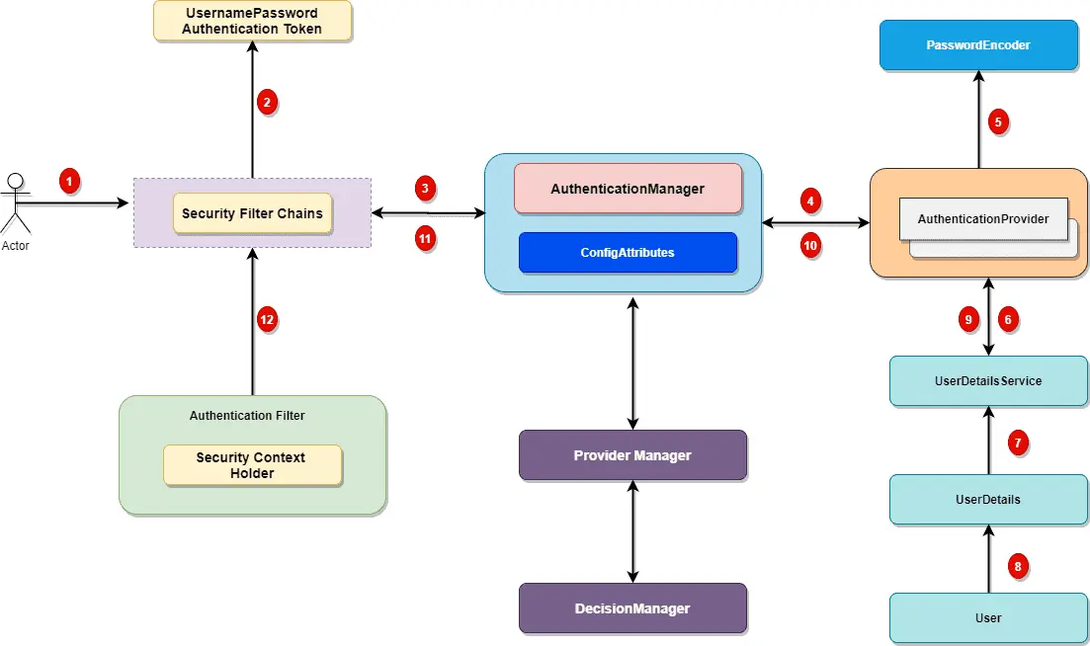

Slide 19
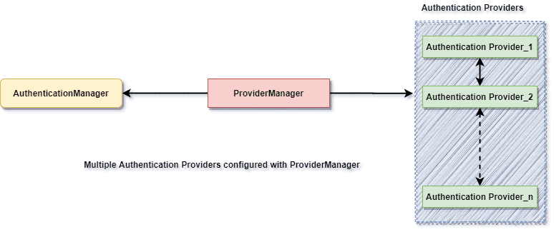

Slide 20
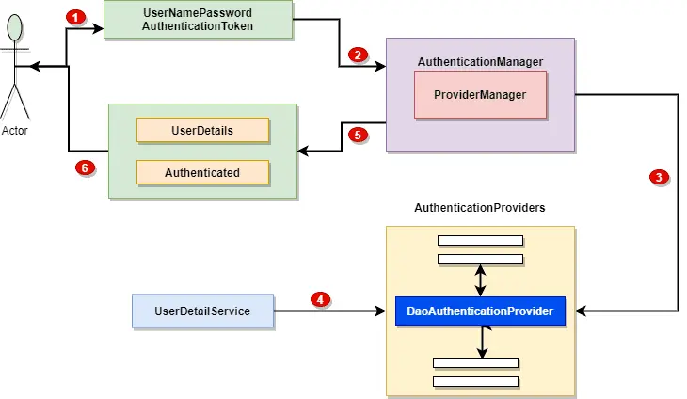
Spring Security Authentication Providers

Slide 21
Authentication & Authorization basics
There are multiple ways to authenticate our RESTful web services. The basic way is to use basic authentication.
In the basic authentication, we send a username and password as part of our request. When we provide a username and password, it allows us to access the resource.
There are other advanced forms of authentication like digest authentication, where the password digest is created, and the digest is sent across. It does not send the actual password to the server.
The other advanced form of authentication is OAuth (Open Authorization) or OAuth2 authentication.

Slide 22
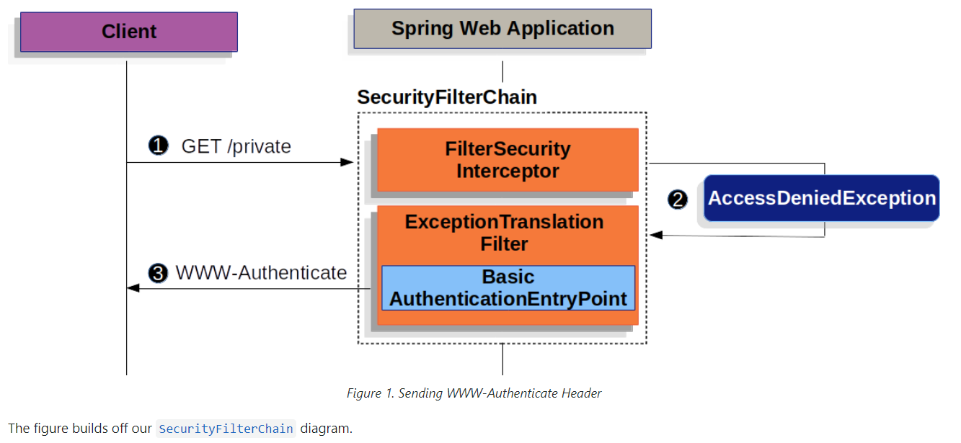
Basic Authentication

Slide 23
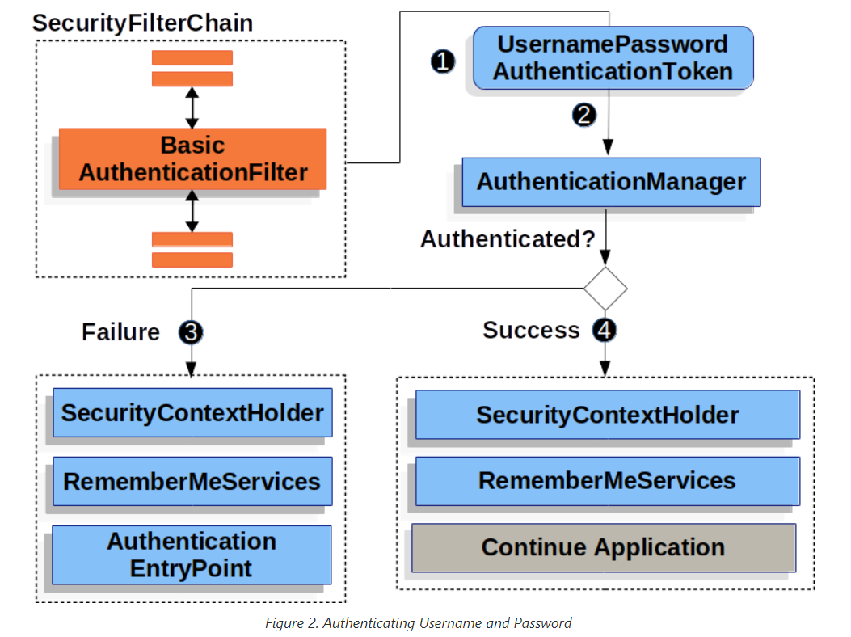

Slide 24
Implementing In memory & database authentication
In-memory database relies on system memory as oppose to disk space for storage of data.
Because memory access is faster than disk access. We use the in-memory database when we do not need to persist the data.
The in-memory database is an embedded database. The in-memory databases are volatile, by default, and all stored data loss when we restart the application.
The widely used in-memory databases are H2, HSQLDB (HyperSQL Database), and Apache Derby. It creates the configuration automatically.

Slide 25
What is the H2 Database
H2 is an embedded, open-source, and in-memory database. It is a relational database management system written in Java. It is a client/server application. It is generally used in unit testing. It stores data in memory, not persist the data on disk.
Advantages
Zero configuration
It is easy to use.
It is lightweight and fast.
It provides simple Configuration to switch between a real database and in-memory database.
It supports standard SQL and JDBC API.
It provides a web console to maintain in the database.

Slide 26
JWT
JSON Web Token (JWT) is an open standard (RFC 7519) that specifies a compact and self-contained way of transmitting information securely as a JSON object between parties.
This information can be verified and trusted as it has been digitally signed.
It can also hold all the user's claim, like authorization information, so that the service provider does not need to access the database to validate user roles and permissions for each request; data is extracted from the token.

Slide 27
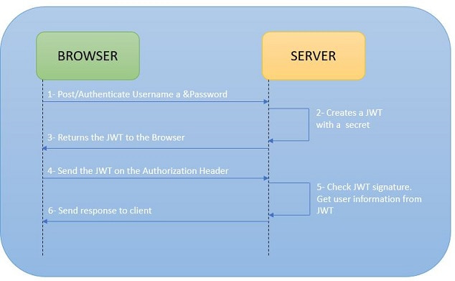
JWT Workflow

Slide 28
Customers sign in by submitting their credentials to the provider.
Upon successful authentication, it generates JWT containing user details and privileges for accessing the services and sets the JWT expiry date in payload.
The server signs and encrypts the JWT if necessary and sends it to the client as a response with credentials to the initial request.
Based on the expiration set by the server, the customer/client stores the JWT for a restricted or infinite amount of time.
The client sends this JWT token in the header for all subsequent requests.
The client authenticates the user with this token. So we don't need the client to send the user name and password to the server during each authentication process, but only once the server sends the client a JWT.

Slide 29
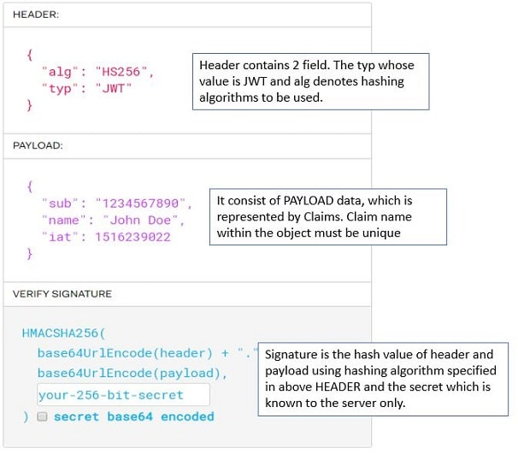
JWT Structure

Slide 30
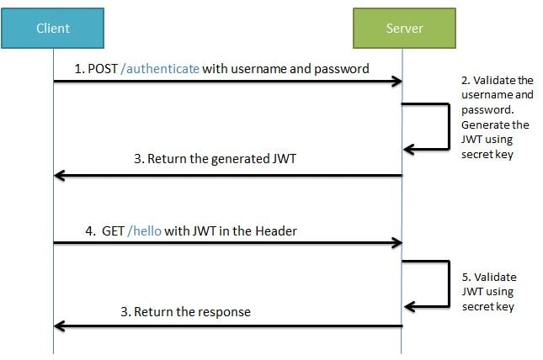

Slide 31
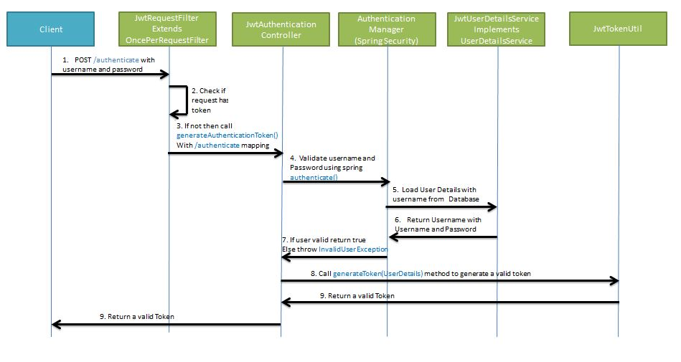
Generating JWT

Slide 32
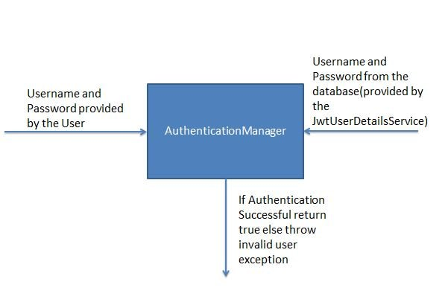

Slide 33
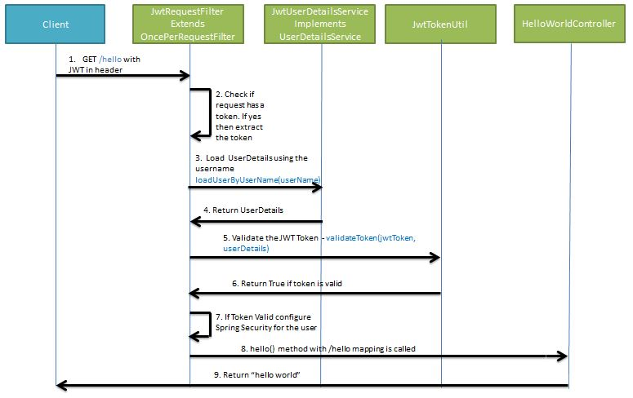

Slide 34
Spring Boot Security - Introduction to OAuth2
OAuth (Open Authorization) is a simple way to publish and interact with protected data.
It is an open standard for token-based authentication and authorization on the Internet. It allows an end user's account information to be used by third-party services, such as Facebook, without exposing the user's password.
The OAuth specification describes five grants for acquiring an access token:
Authorization code grant
Implicit grant
Resource owner credentials grant
Client credentials grant
Refresh token grant

Slide 35
OAuth 2 is an authorization method to provide access to protected resources over the HTTP protocol. Primarily, oauth2 enables a third-party application to obtain limited access to an HTTP service –
either on behalf of a resource owner by orchestrating an approval interaction between the resource owner and the HTTP service
or by allowing the third-party application to obtain access on its own behalf.

Slide 36
Roles
OAuth defines four roles –
Resource Owner – The user of the application.
Client – the application (user is using) which require access to user data on the resource server.
Resource Server – store user’s data and http services which can return user data to authenticated clients.
Authorization Server – responsible for authenticating user’s identity and gives an authorization token. This token is accepted by resource server and validate your identity.

Slide 37
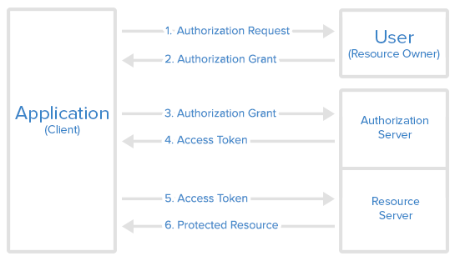

Slide 38
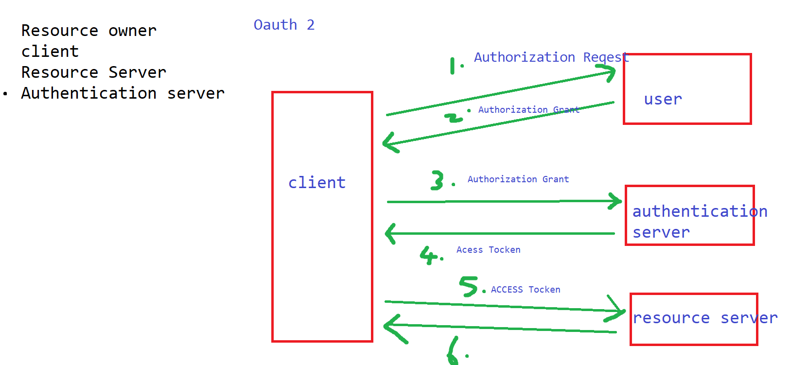

Slide 39
Access Token vs Refresh Token
An access token is a string representing an authorization issued to the client. Tokens represent specific scopes and durations of access, granted by the resource owner, and enforced by the resource server and authorization server.
The refresh token is issued (along with the access token) to the client by the authorization server, and it is used to obtain a new access token when the current access token becomes invalid or expires.
The refresh token is also used to get additional access tokens with identical or narrower scope (access tokens may have a shorter lifetime and fewer permissions than authorized by the resource owner). Issuing a refresh token is optional at the discretion of the authorization server.
The responsibility of access token is to access data before it gets expired.
The responsibility of refresh token is to request for a new access token when the existing access token is expired.

Slide 40
https://docs.spring.io/spring-security/site/docs/3.1.x/reference/springsecurity-single.html
Ref: https://docs.spring.io/spring-security/oauth/site/docs/2.5.2.RELEASE/apidocs/index.html

